Slide 1
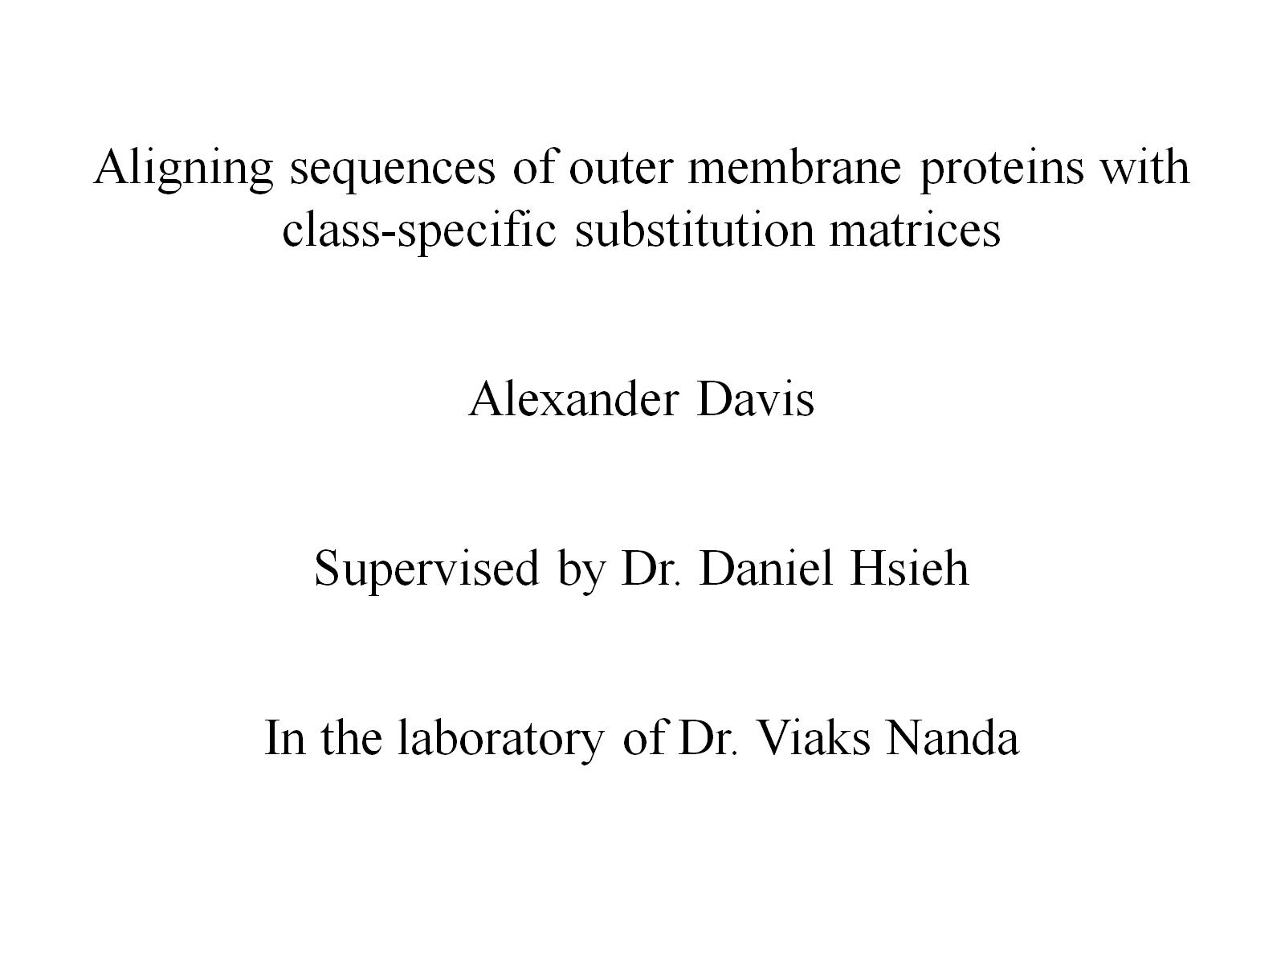

Slide 2
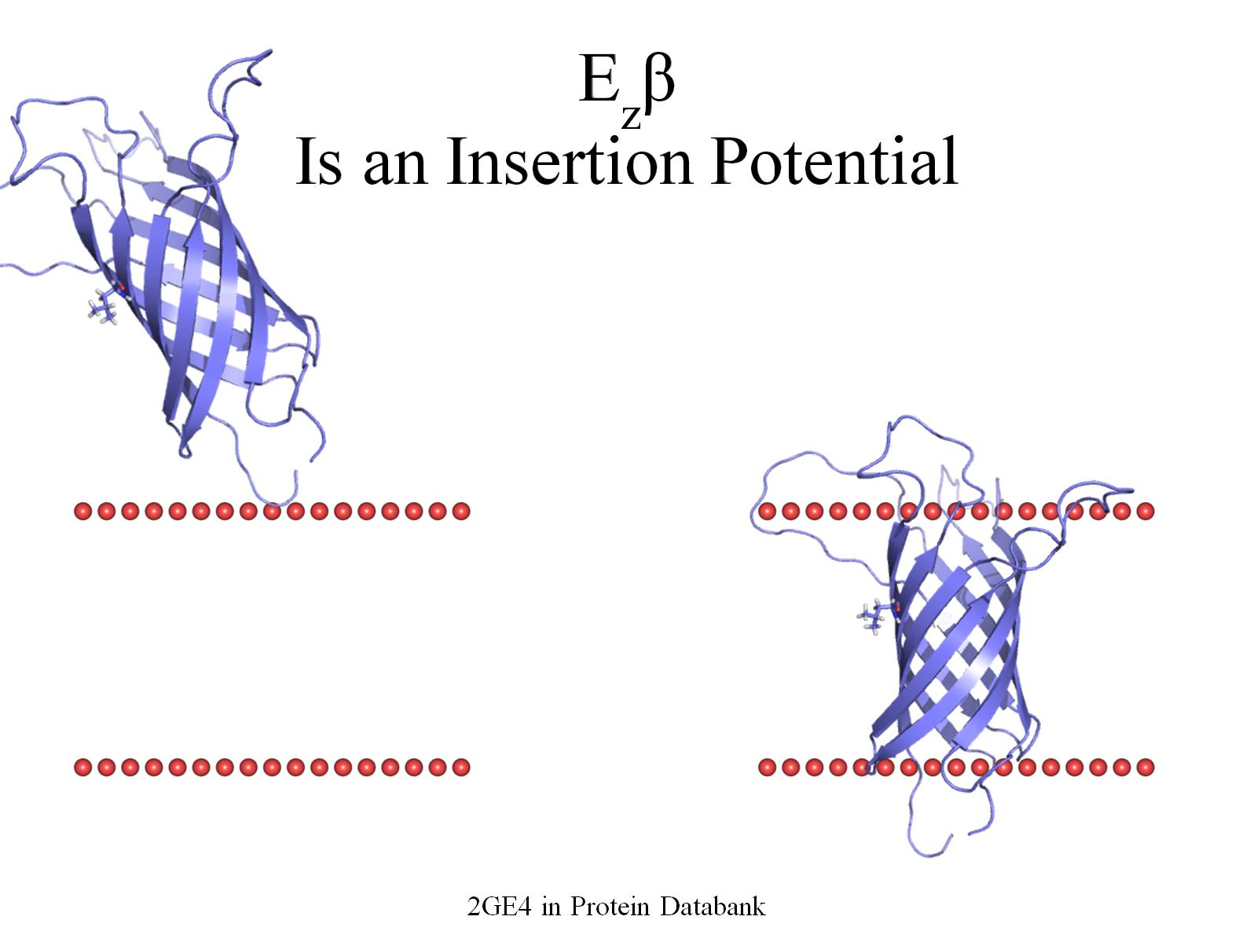
E_{z}β Is an Insertion Potential

Slide 3
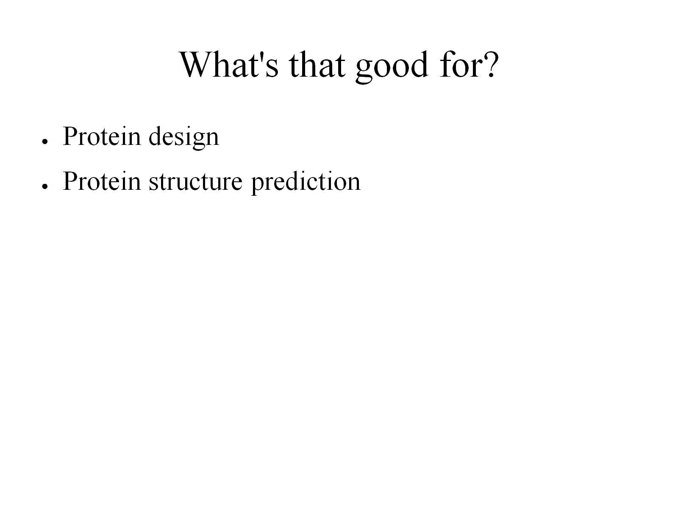
What's that good for?

Slide 4
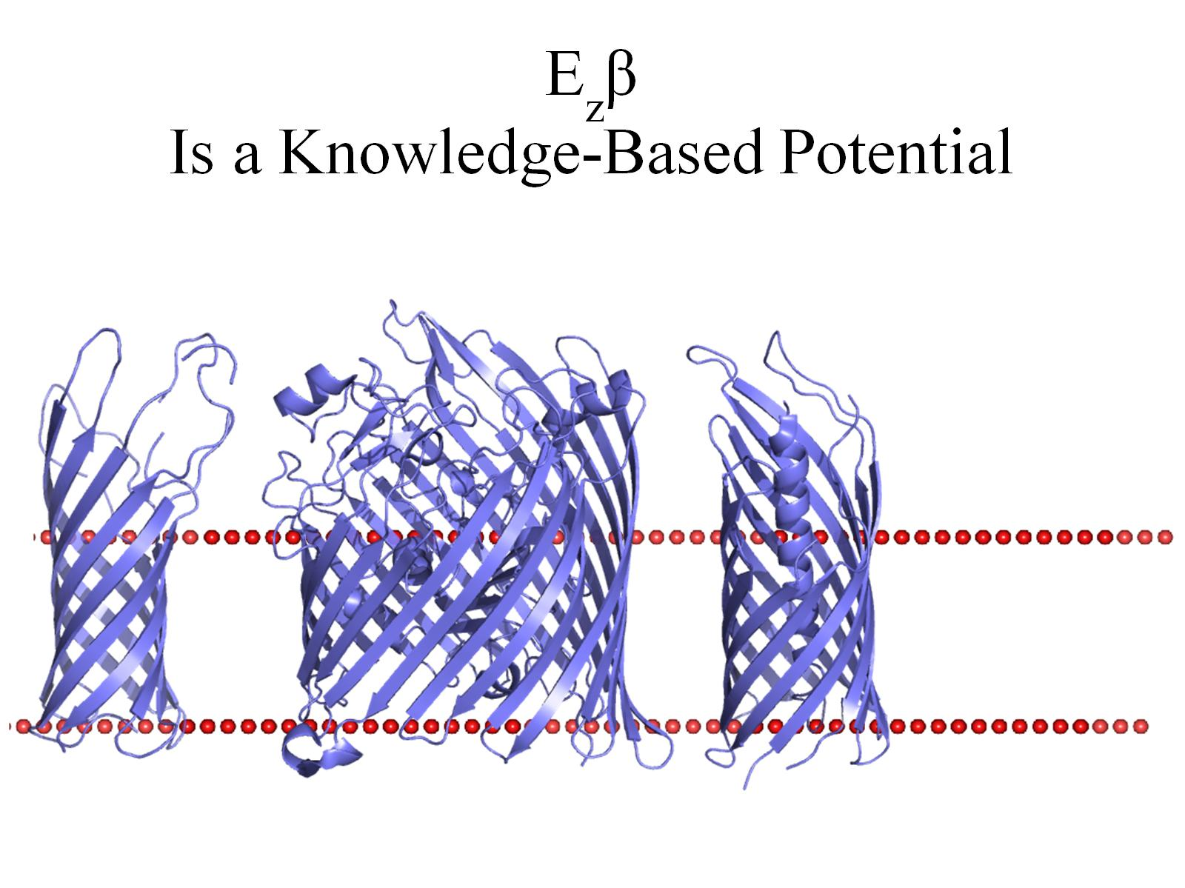
E_{z}β Is a Knowledge-Based Potential

Slide 5

E_{z}β Is a Knowledge-Based Potential

Slide 6
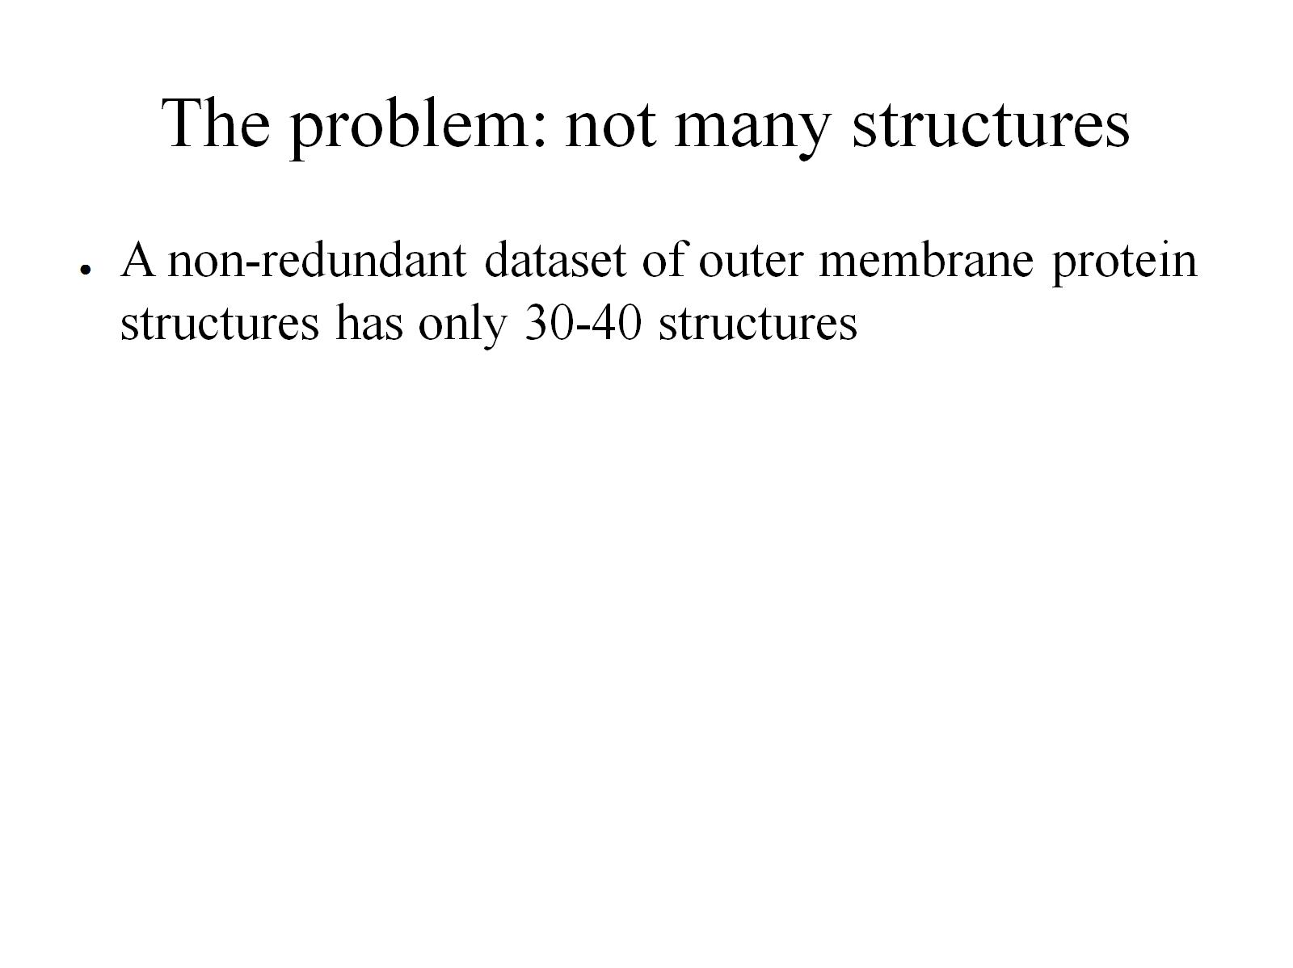
The problem: not many structures

Slide 7
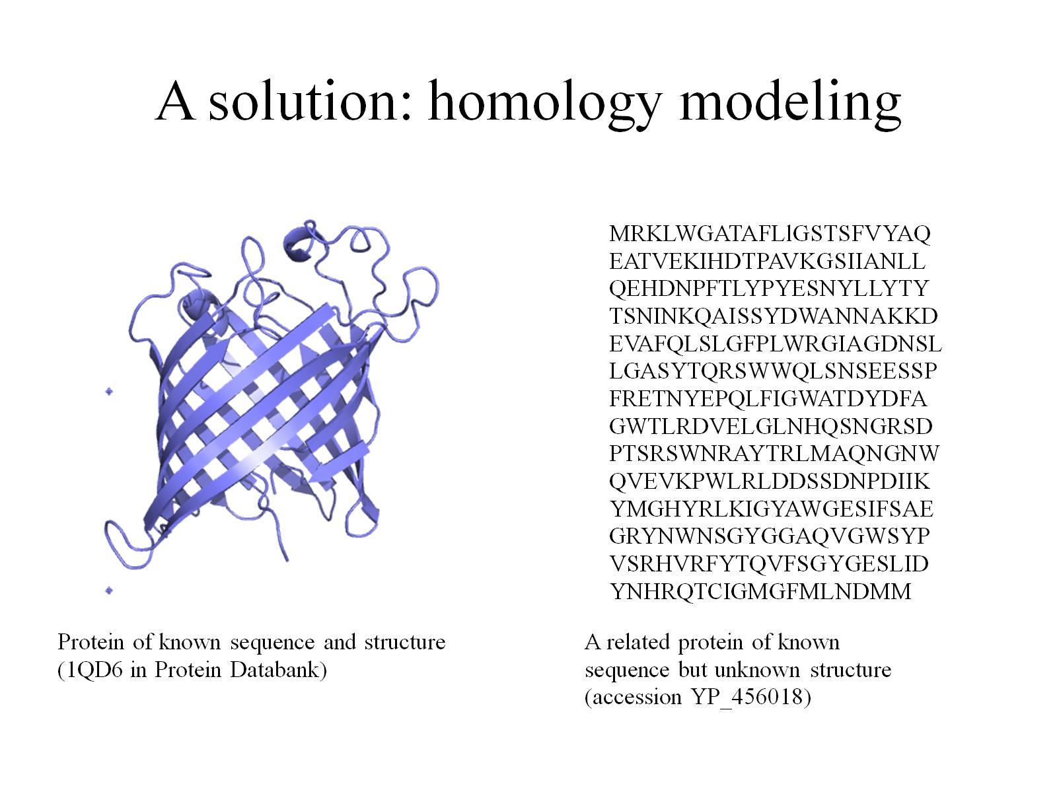
A solution: homology modeling

Slide 8
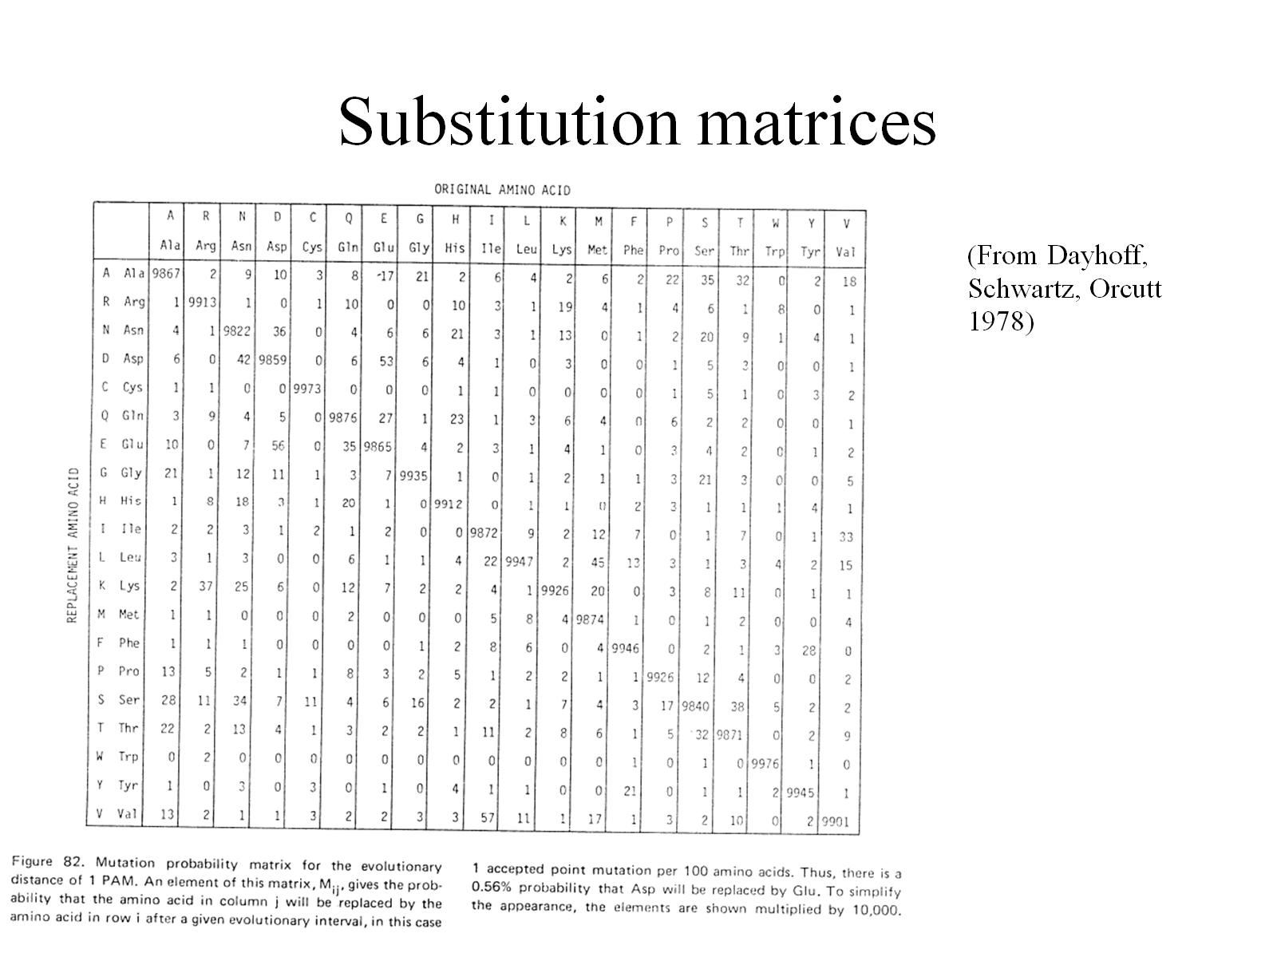
Substitution matrices

Slide 9
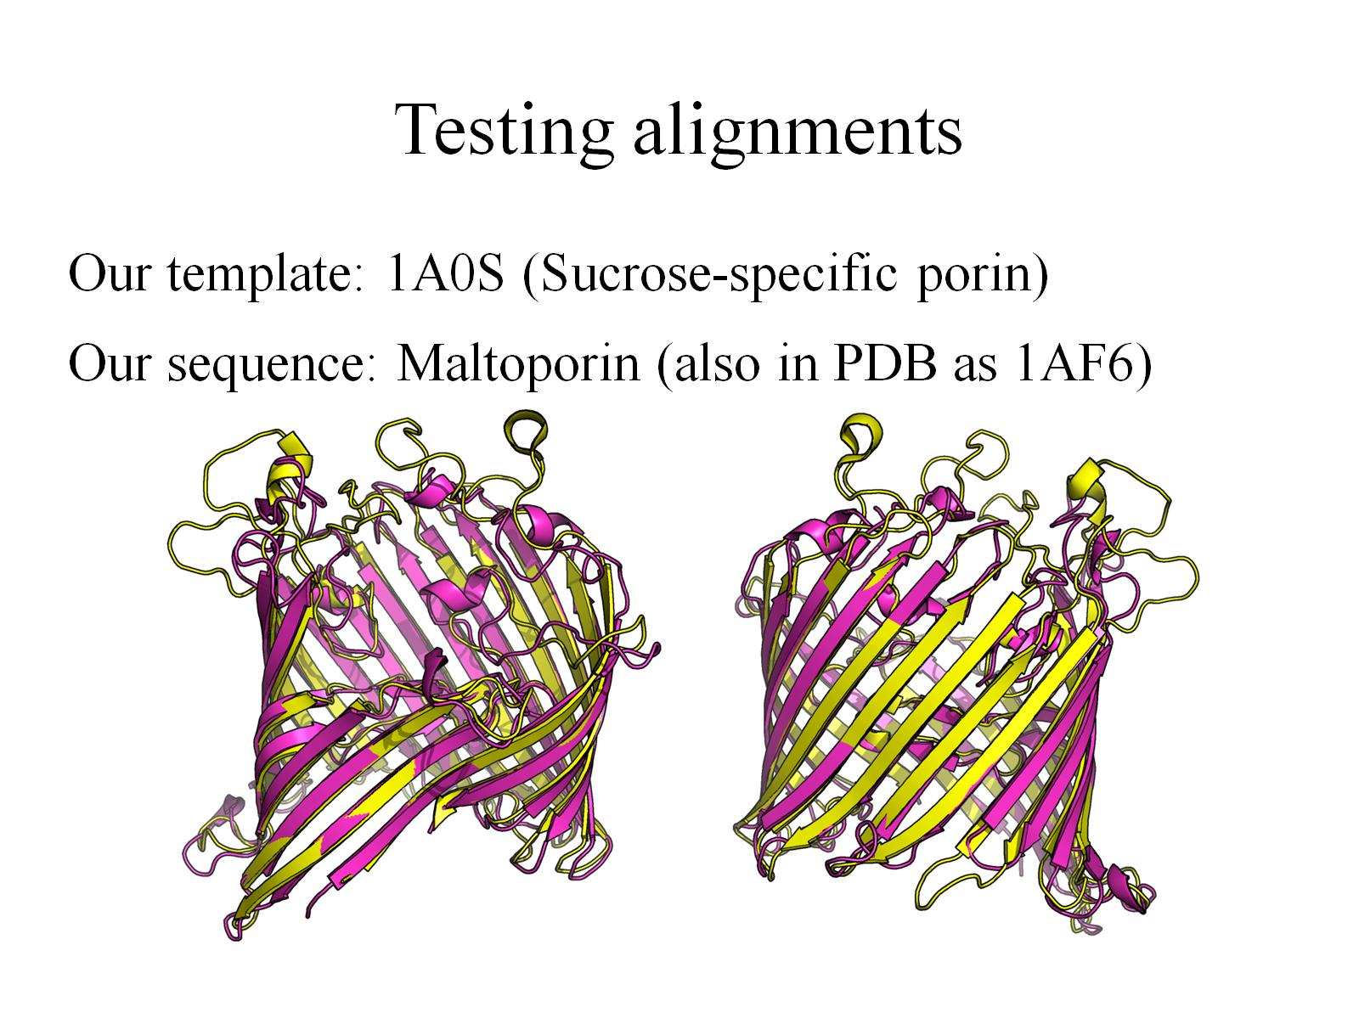
Testing alignments

Slide 10
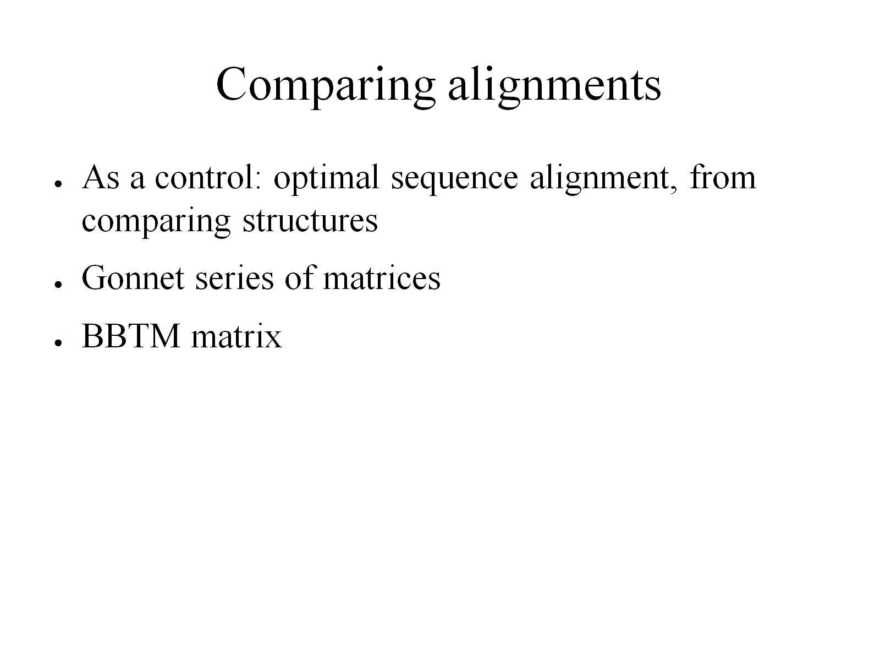
Comparing alignments

Slide 11
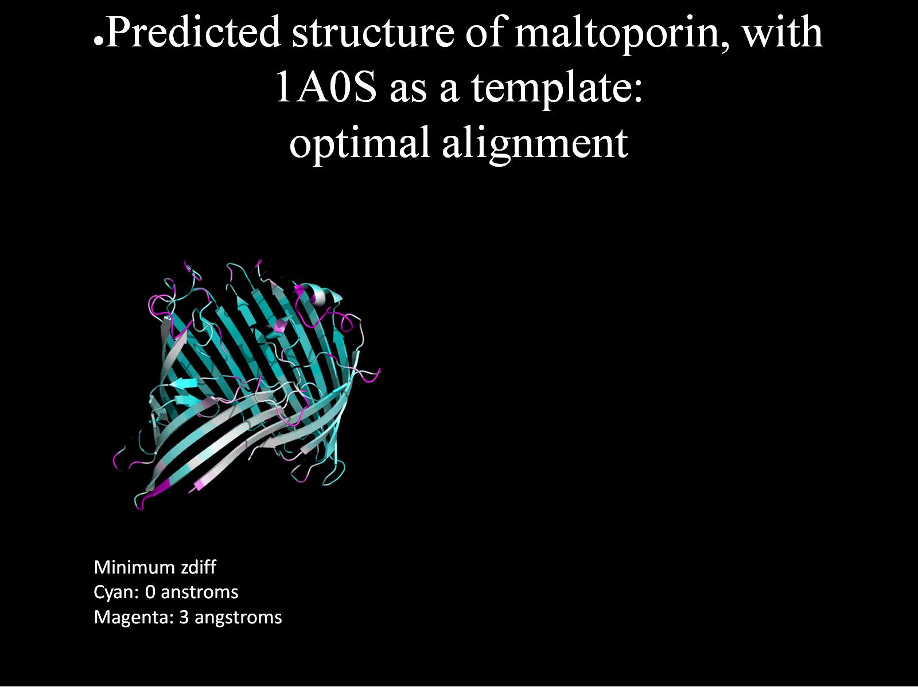
Predicted structure of maltoporin, with 1A0S as a template: optimal alignment

Slide 12
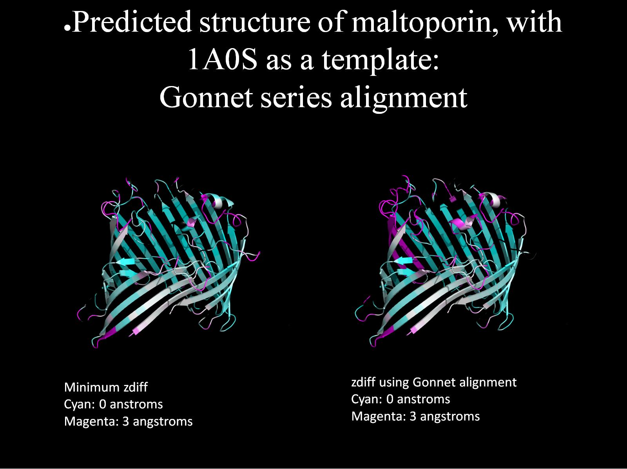
Predicted structure of maltoporin, with 1A0S as a template: Gonnet series alignment

Slide 13
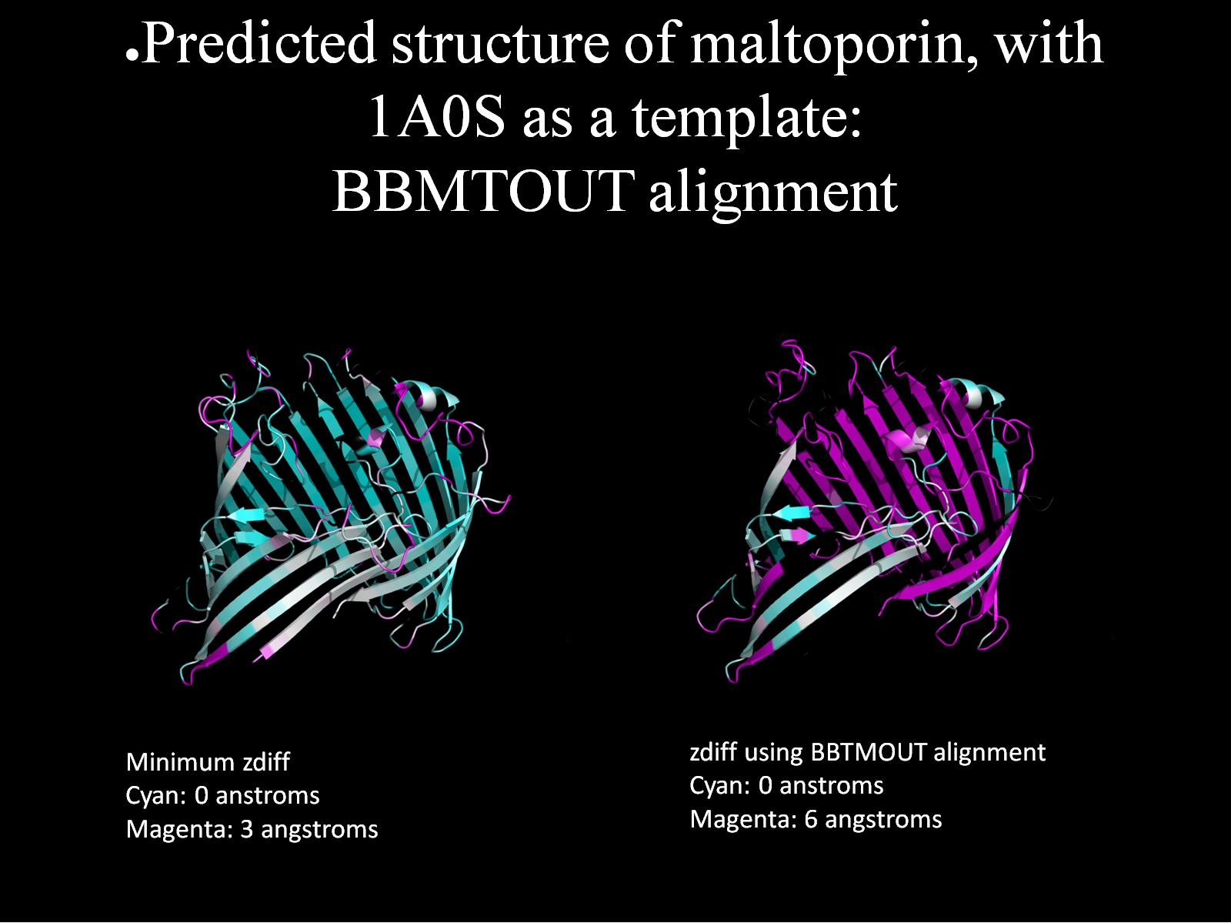
Predicted structure of maltoporin, with 1A0S as a template: BBMTOUT alignment

